Slide 1






Data Mining
Presented by : Amirfazel Koozegar Kaleji
Student number : 9931099

Slide 2
What is data mining?
Data mining is a key part of data analytics overall and one of the core disciplines in data science, which uses advanced analytics techniques to find useful information in data sets. At a more granular level, data mining is a step in the knowledge discovery in databases (KDD) process, a data science methodology for gathering, processing and analyzing data.
Data mining is the process of sorting through large data sets to identify patterns and relationships that can help solve business problems through data analysis. Data mining techniques and tools enable enterprises to predict future ends and make more-informed business decisions.
Data mining and KDD are sometimes referred to interchangeably, but they're more commonly seen as distinct things.

Slide 3
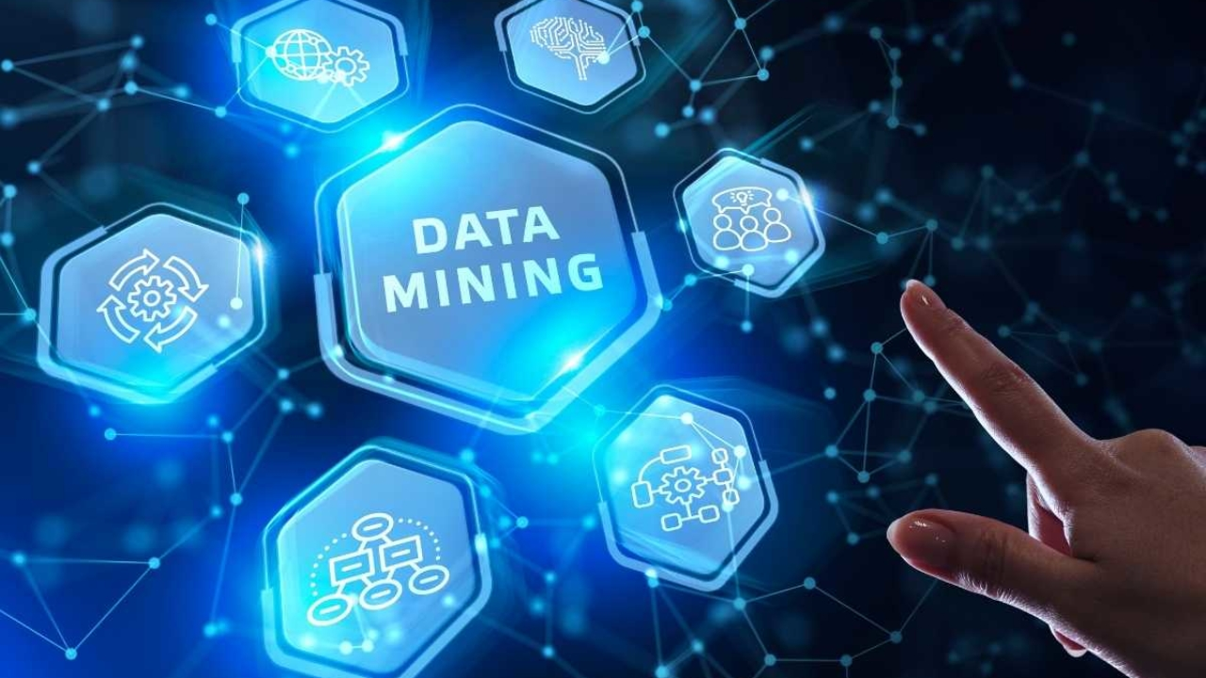
Importance of Data Mining
Data mining is a crucial component of successful analytics initiatives in organizations. The information it generates can be used in business intelligence (BI) and advanced analytics applications that involve analysis of historical data, as well as real-time analytic applications that examine streaming data as it's created or collected.

Slide 4
How does it work?
Data mining is typically done by data scientists and other skilled BI and analytics professionals. But it can also be performed by data-savvy business analysts, executives and workers who function as citizen data scientists in an organization.
Its core elements include machine learning and statistical analysis, along with data management tasks done to prepare data for analysis. The use of machine learning algorithms and artificial intelligence (AI) tools has automated more of the process and made it easier to mine massive data sets, such as customer databases, transaction records and log files from web servers, mobile apps and sensors.

Slide 5
The data mining process can be broken down into these four primary stages:

Slide 6



1.
Data gathering
Relevant data for an analytics application is identified and assembled. The data may be located in different source systems, a data warehouse or a data lake, an increasingly common repository in big data environments that contain a mix of structured and unstructured data. External data sources may also be used. Wherever the data comes from, a data scientist often moves it to a data lake for the remaining steps in the process.

Slide 7
2.
Data Preparation
This stage includes a set of steps to get the data ready to be mined. It starts with data exploration, profiling and pre-processing, followed by data cleansing work to fix errors and other data quality issues. Data transformation is also done to make data sets consistent, unless a data scientist is looking to analyze unfiltered raw data for a particular application.

Slide 8
3.
Mining the data
Once the data is prepared, a data scientist chooses the appropriate data mining technique and then implements one or more algorithms to do the mining. In machine learning applications, the algorithms typically must be trained on sample data sets to look for the information being sought before they're run against the full set of data.

Slide 9
4.
Data analysis and interpretation
The data mining results are used to create analytical models that can help drive decision-making and other business actions. The data scientist or another member of a data science team also must communicate the findings to business executives and users, often through data visualization and the use of data story telling techniques.

Slide 10
Types of data mining techniques
Association rule mining
Classification
Clustering
Regression
Sequence and path analysis
Neural networks

Slide 11








Benefits of Data Mining

Slide 12
More effective marketing and sales
Data mining helps marketers better understand customer behavior and preferences, which enables them to create targeted marketing and advertising campaigns
Better customer service
Thanks to data mining, companies can identify potential customer service issues more promptly and give contact center agents up-to-date information to use in calls and online chats with customers.

Slide 13

New Words

Slide 14
Data mining analytics disciplines grangular data-savvy cleansing execuitive clustering regression

Slide 15

Thanks!

Slide 16
Source
Gathered all the info from this site.

